Slide 1

Student Result Management System

Slide 2

Introduction
Student Management system generate the Student result record and to add their record update it.
This system make easy to store record of each and every student

Slide 3

Features
Home page
Student login
Admin login
Contact us

Slide 4
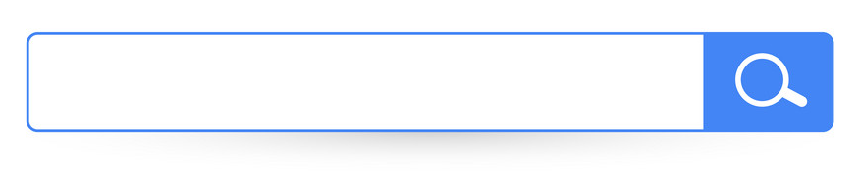
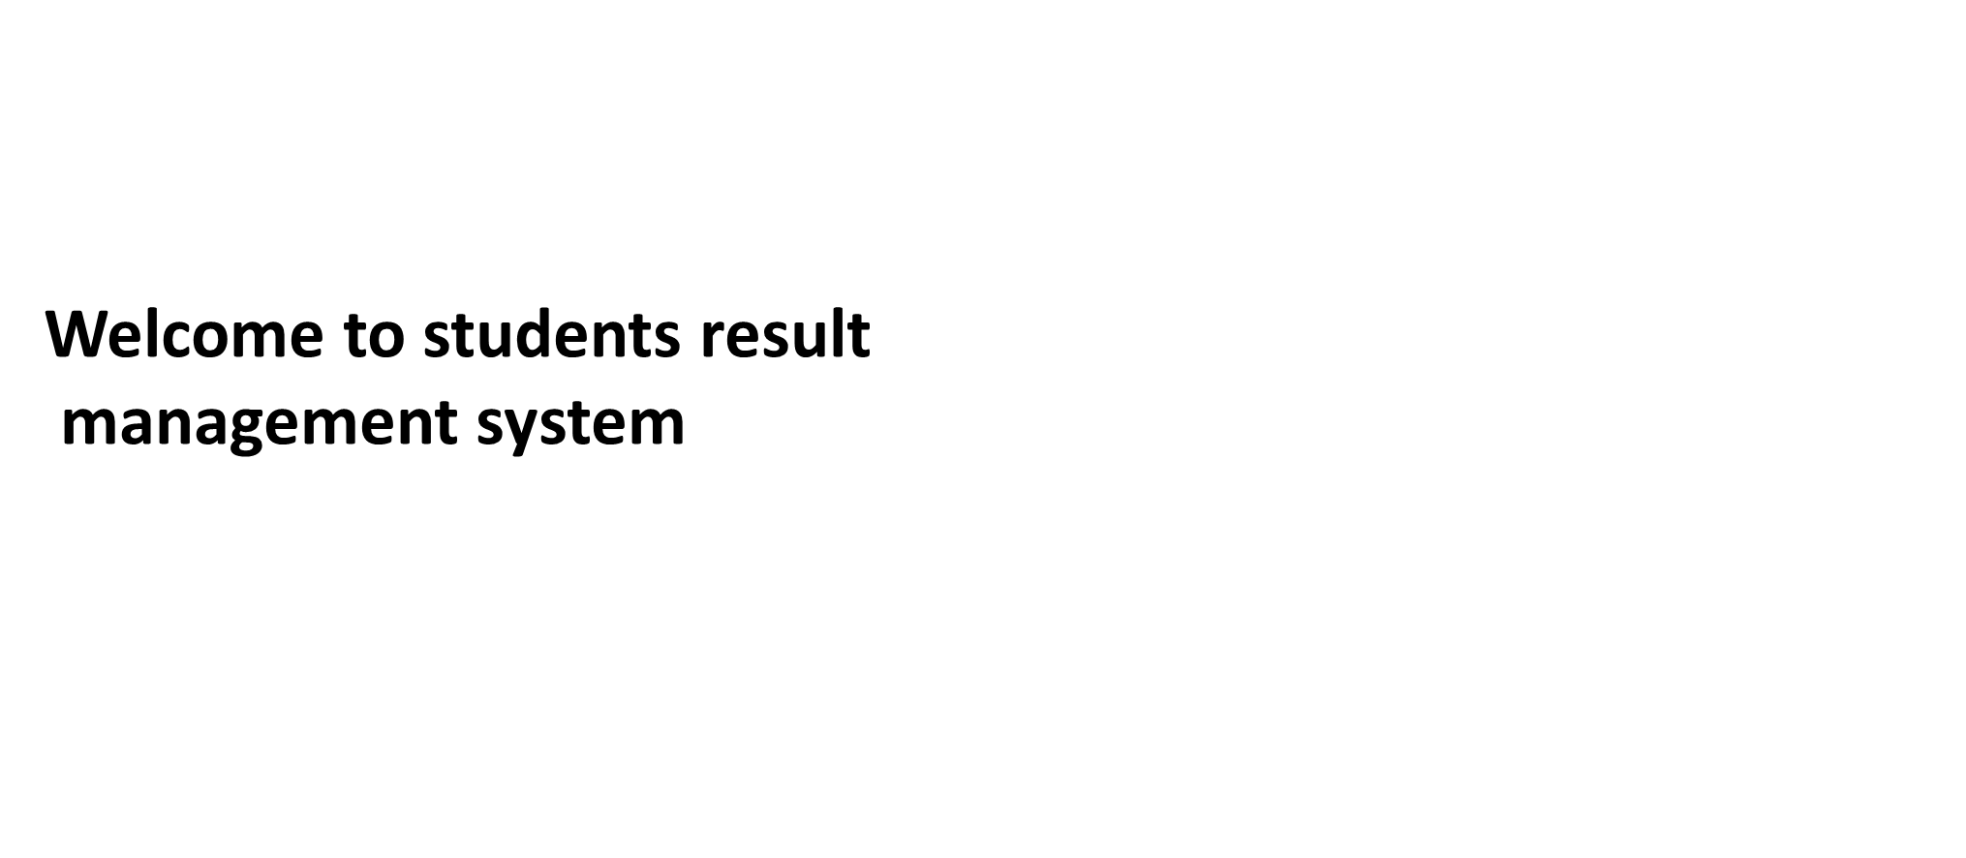

Home
Student
Admin

Slide 5

STUDENT LOGIN
Login
Username
Password
Enter

Slide 6
Result
Name : Semester : Roll No. :
Subject | Total Marks | Passing Marks | Marks Obtained
BIT101 | 100 | 40 | 80
BIT102 | 100 | 40 | 70
BIT103 | 100 | 40 | 80

Slide 7

Welcome Admin
Login
User ID
Password
Login
Back

Slide 8
Add New Student
Department Name
Insert New Result
Course Name
Registered Student
Student Name
All Student Result
ID No.
Log Out
Create

Slide 9
.
Add New Student
ID NO.
Insert New Result
Physics
Registered Student
Chemistry
All Student Result
Bio
Log Out
Save

Slide 10
.
Add New Student
Student ID | Name | Class
S6001 | Medha | BIT
S6002 | Chetan | BIT
S6003 | Riva | BIT
S6004 | Prince | BIT
Insert New Result
Registered Student
All Student Result
Log Out

Slide 11
.
Add New Student
Student ID | BIT101 | BIT102 | BIT103
S6001 | 80 | 70 | 80
S6002 | 80 | 80 | 75
S6003 | 90 | 70 | 75
S6004 | 60 | 70 | 80
Insert New Result
Registered Student
All Student Result
Log Out

Slide 12

Contact Us
“We're here to assist you. Reach out anytime!”
First name: - ……………………………………
Last name:- …………………………..
Email: - ………………………
Phone no.: - …………………………..
Questions or comments: - ……………………………
Level 3, 1 Fake street Sydney, NSW 2000
+61 433 334 433
info@college.edu.au
Submit

